Slide 1
OOPs concepts in Java
Object-oriented programming System(OOPs) is a programming paradigm based on the concept of “objects” that contain data and methods.
The primary purpose of object-oriented programming is to increase the flexibility and maintainability of programs.
Object oriented programming brings together data and its behavior(methods) in a single location(object) makes it easier to understand how a program works

Slide 2
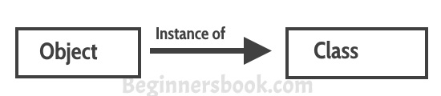
Characteristics of Objects:
Abstraction
Encapsulation
Abstraction: Abstraction is a process where you show only “relevant” data and “hide” unnecessary details of an object from the user.
Encapsulation: Encapsulation simply means binding object state(fields) and behaviour(methods) together. If you are creating class, you are doing encapsulation.

Slide 3
Inheritance
Inheritance can be defined as the process where one class acquires the properties (methods and fields) of another. With the use of inheritance the information is made manageable in a hierarchical order.
The class which inherits the properties of other is known as subclass (derived class, child class) and the class whose properties are inherited is known as superclass (base class, parent class).

Slide 4
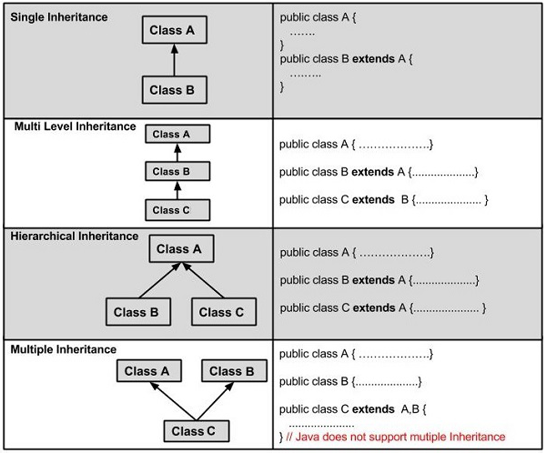
Types of Inheritance:
There are various types of inheritance as demonstrated below:

Slide 5
What is a Class
A class can be considered as a blueprint using which you can create as many objects as you like.

Slide 6
Constructors in Java
Constructor is a block of code that initializes the newly created object.
A constructor resembles an instance method in java but it’s not a method as it doesn’t have a return type.
In short constructor and method are Constructor has same name as the class.

Slide 7
How does a constructor work
To understand the working of constructor, lets take an example.
lets say we have a class MyClass.
When we create the object of MyClass like this:
MyClass obj = new MyClass()
The new keyword here creates the object of class MyClass and invokes the constructor to initialize this newly created object.

Slide 8
Types of constructors:
No argument Constructors
Parameterized Constructors
No argument Constructors
As the name specifies the no argument constructors of Java does not accept any parameters instead, using these constructors the instance variables of a method will be initialized with fixed values for all objects.

Slide 9
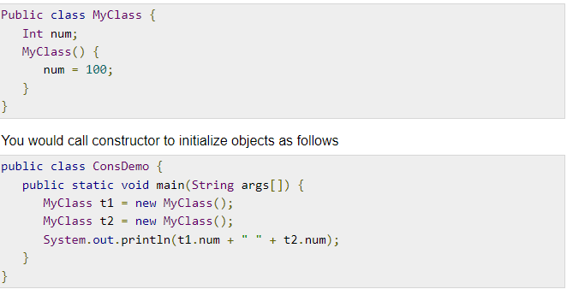
Constructor Definition

Slide 10
Polymorphism:
Poly + Morph
(many ) (form)
2+ 3
2.5 +4.5
a+b

Slide 11
Types of Polymorphism:
Runtime Polymorphism (Method Overriding)
Compile Time Polymorphism (Method Overloading)

Slide 12
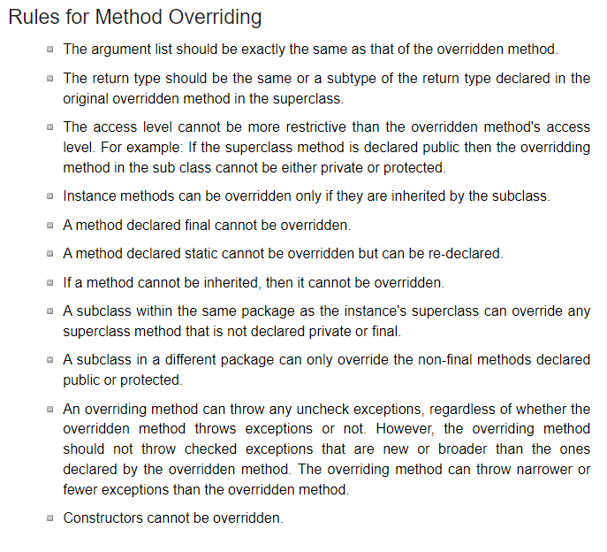

Slide 13
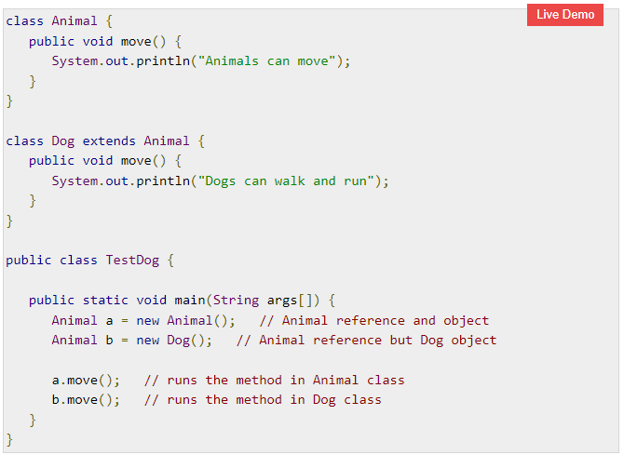
Polymorphism (Method Overriding)

Slide 14
Important Note
In this example, you can see that even though b is a type of Animal it runs the move method in the Dog class. The reason for this is: In compile time, the check is made on the reference type. However, in the runtime, JVM figures out the object type and would run the method that belongs to that particular object.

Slide 15
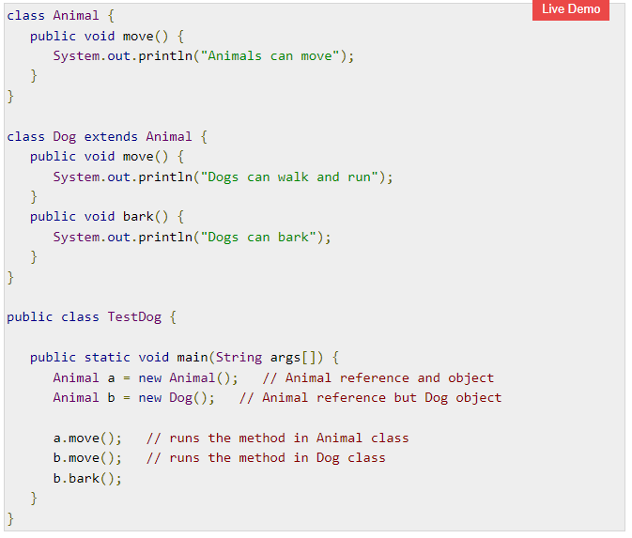

Slide 16
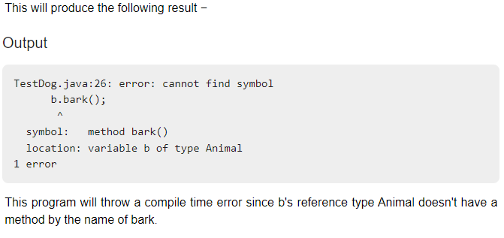

Slide 17
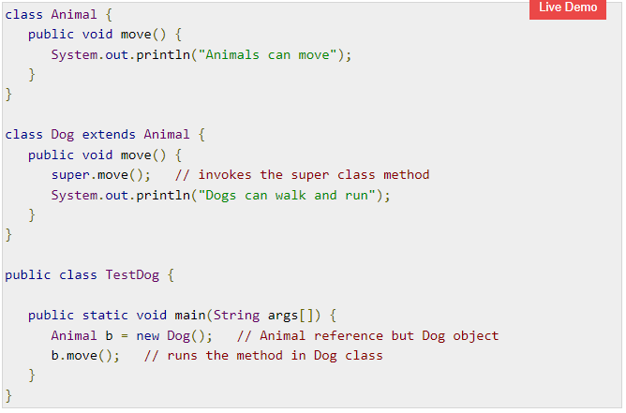

Slide 18
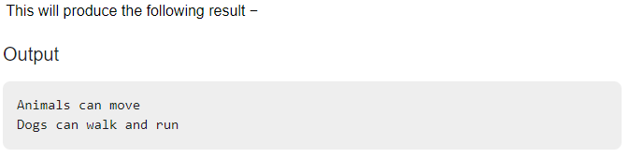

Slide 19
The “super” keyword
It is used to differentiate the members of superclass from the members of subclass, if they have same names.
It is used to invoke the superclass constructor from subclass.
If a class is inheriting the properties of another class. And if the members of the superclass have the names same as the sub class, to differentiate these variables we use super keyword.

Slide 20
super.variable
super.method();

Slide 21
Method Overloading in Java
Method Overloading is a feature that allows a class to have more than one method having the same name, if their argument lists are different.

Slide 22
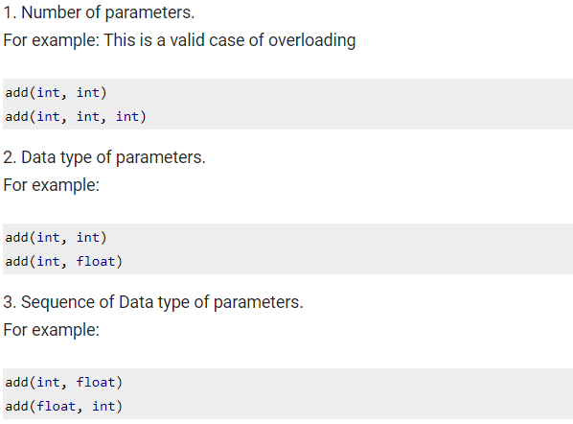
Three ways to overload a method

Slide 23
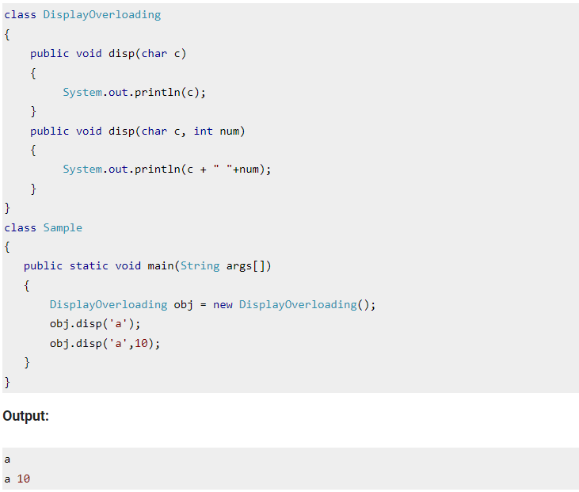

Slide 24
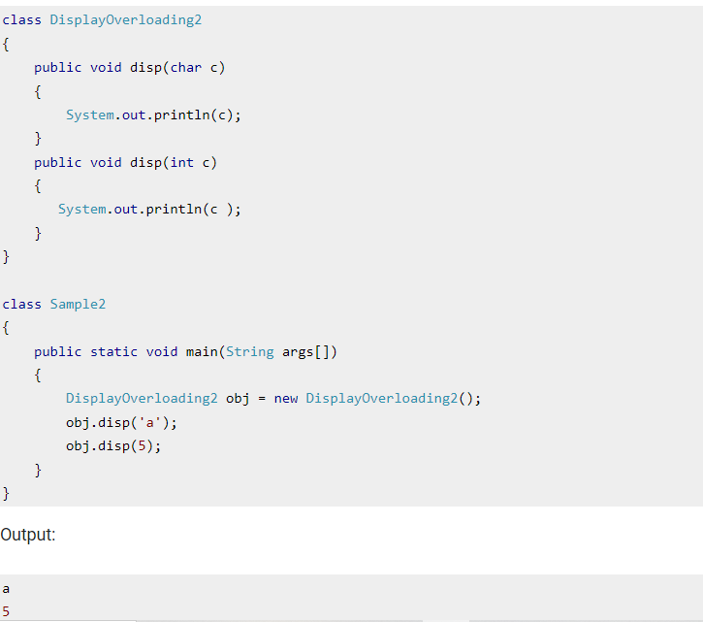

Slide 25
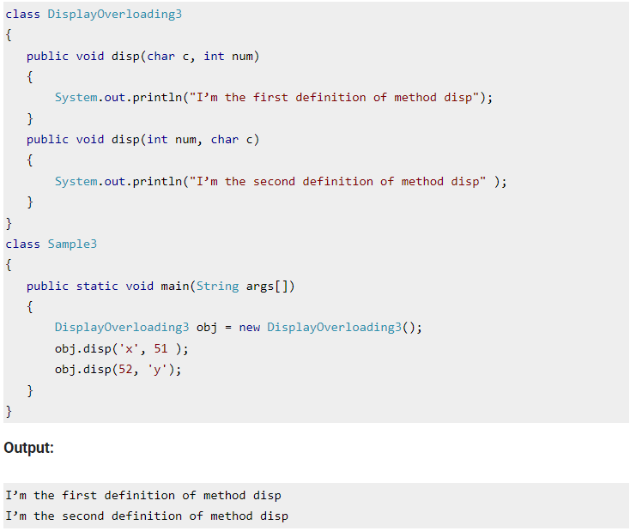

Slide 26
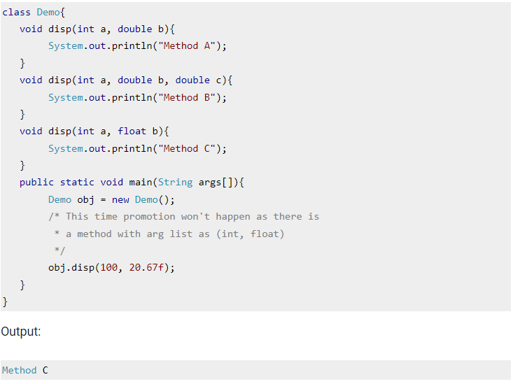

Slide 27
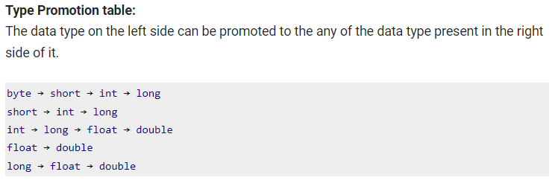

Slide 28
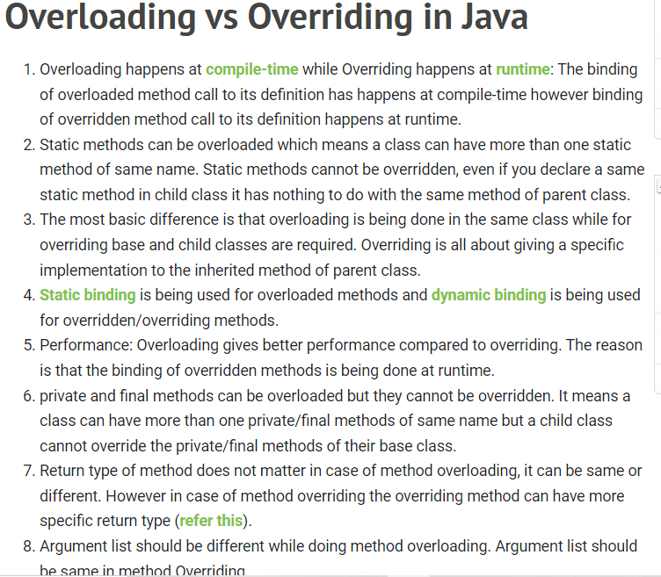

Slide 29
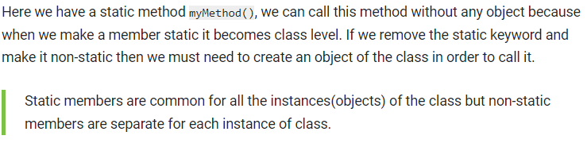
Static Class, Block, Methods and Variables
Static keyword can be used with class, variable, method and block. Static members belong to the class instead of a specific instance, this means if you make a member static, you can access it without object.

Slide 30
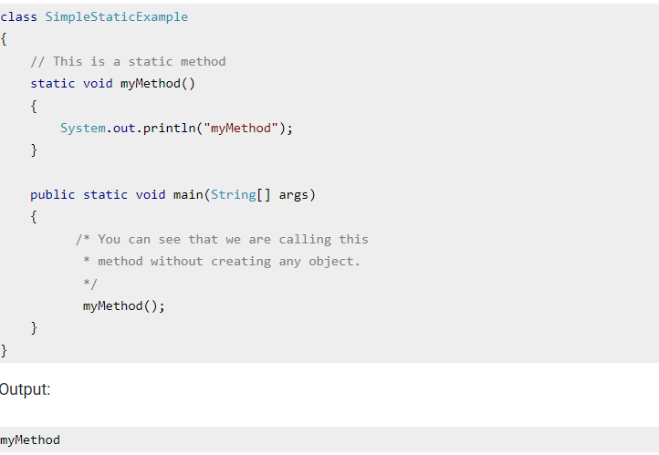

Slide 31
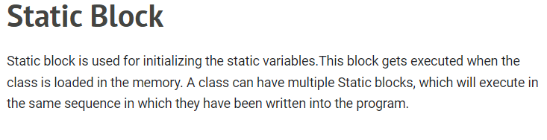

Slide 32
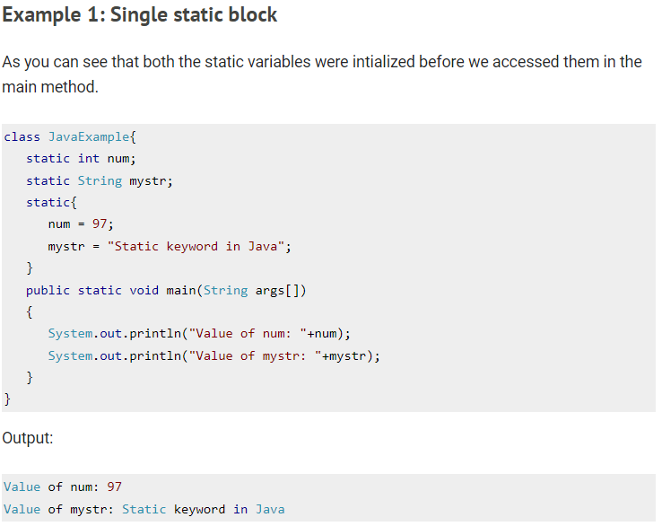

Slide 33
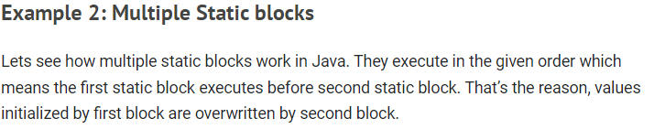

Slide 34
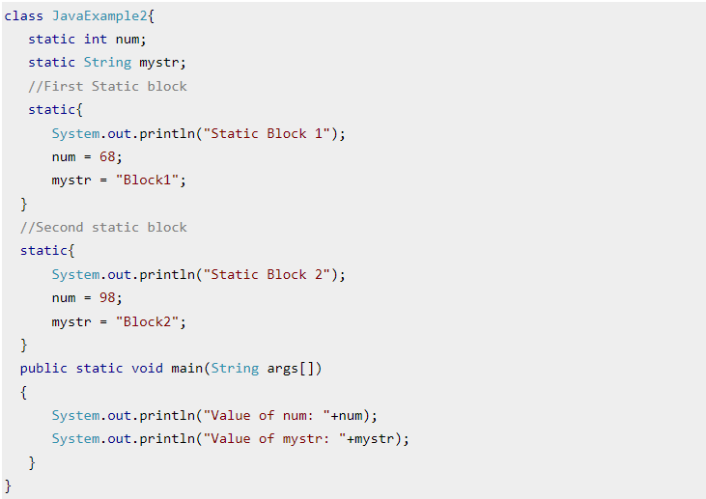
Multiple Static Block:

Slide 35
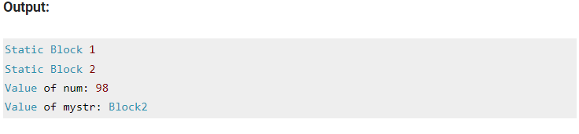
Output (Multiple Static Block)

Slide 36
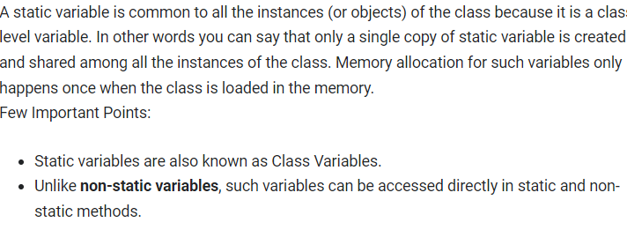
Static Variable:

Slide 37
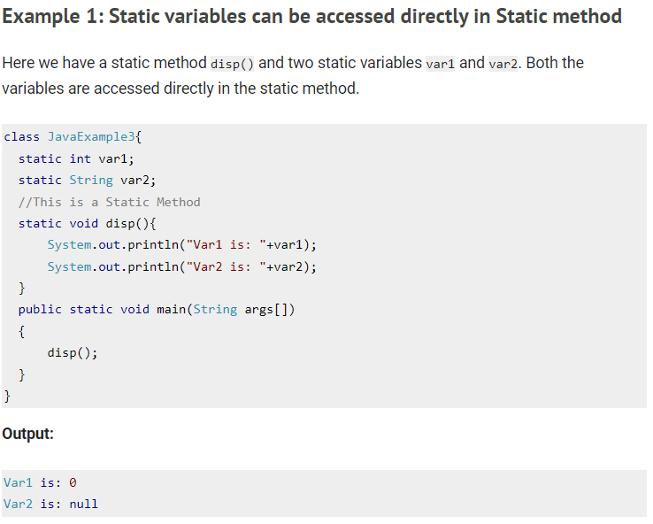

Slide 38
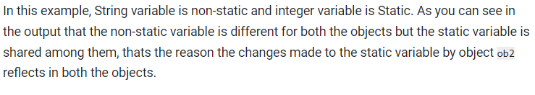
Static variables are shared among all objects:

Slide 39
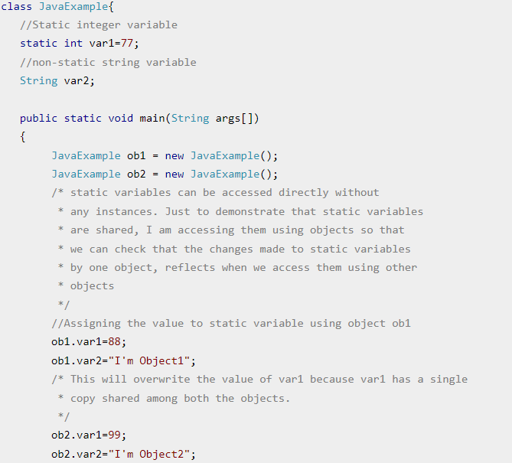

Slide 40
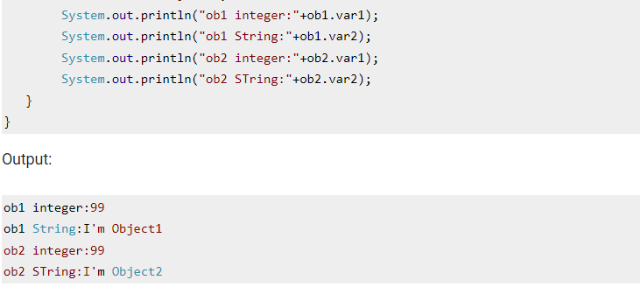

Slide 41
THANKS

